Slide 1


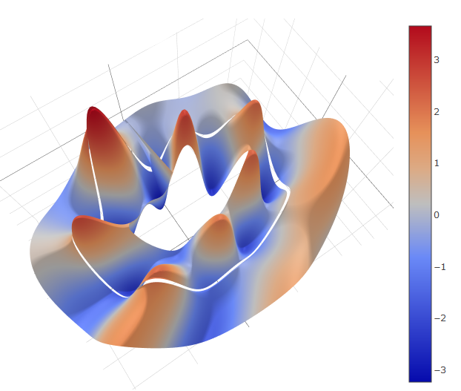
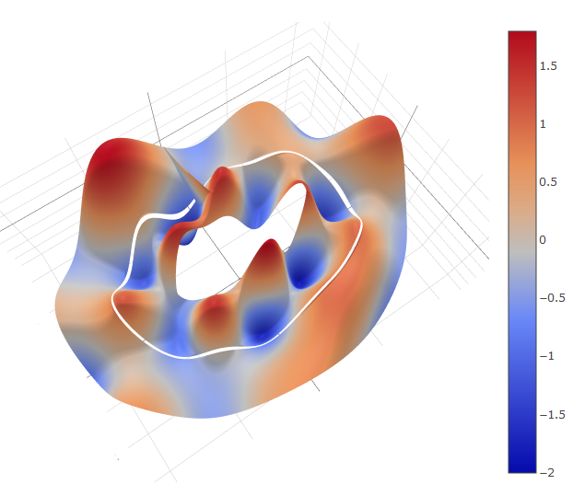
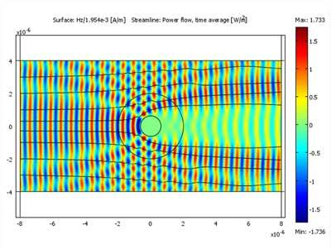
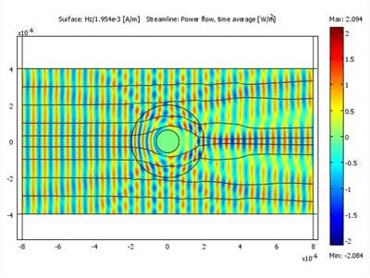
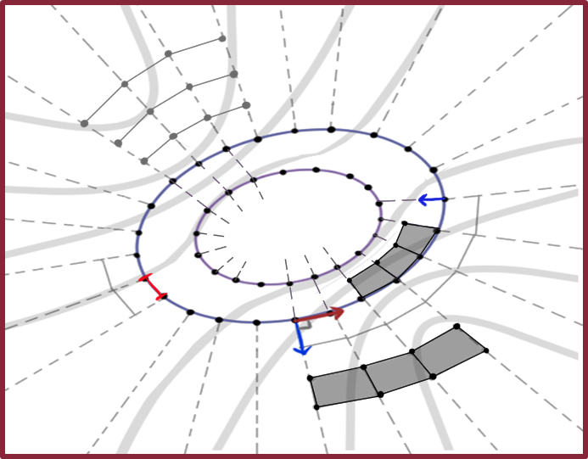
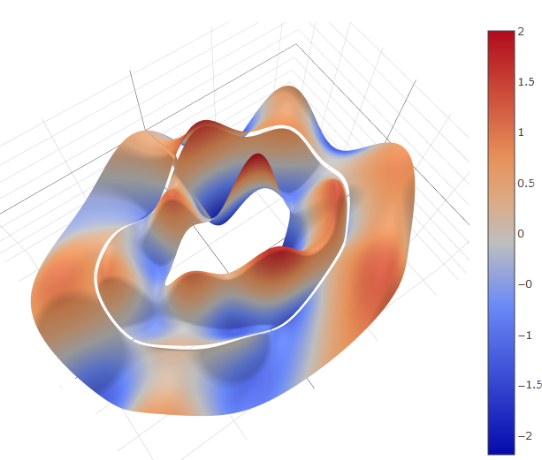
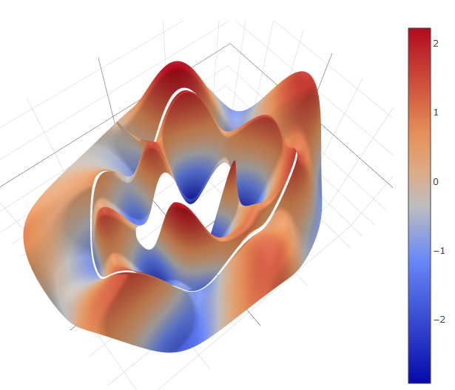
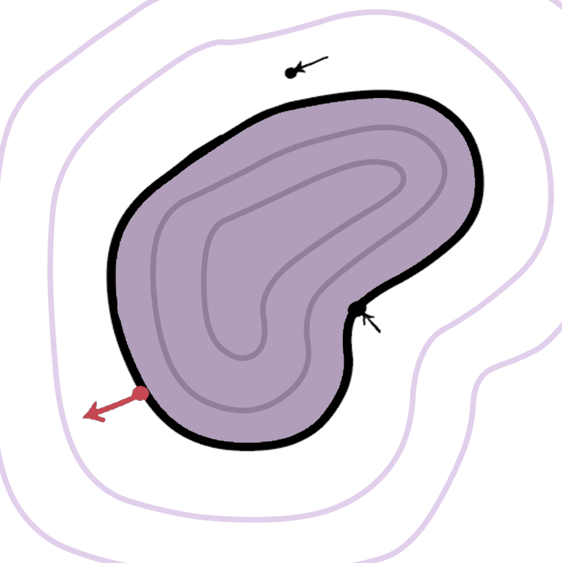
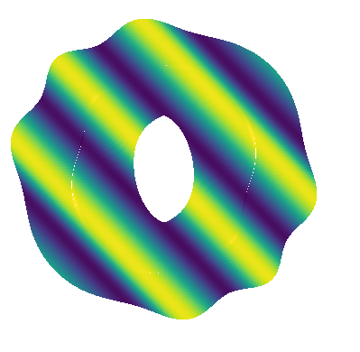
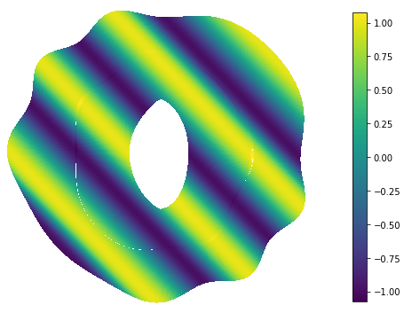
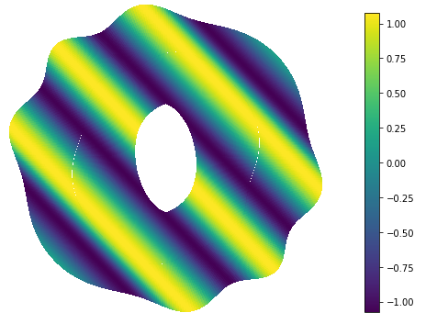
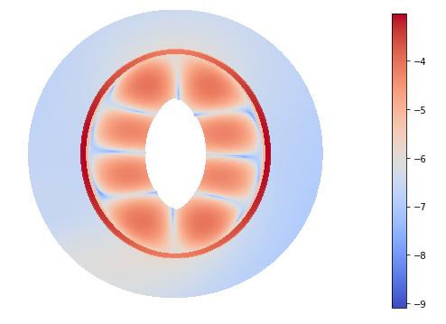

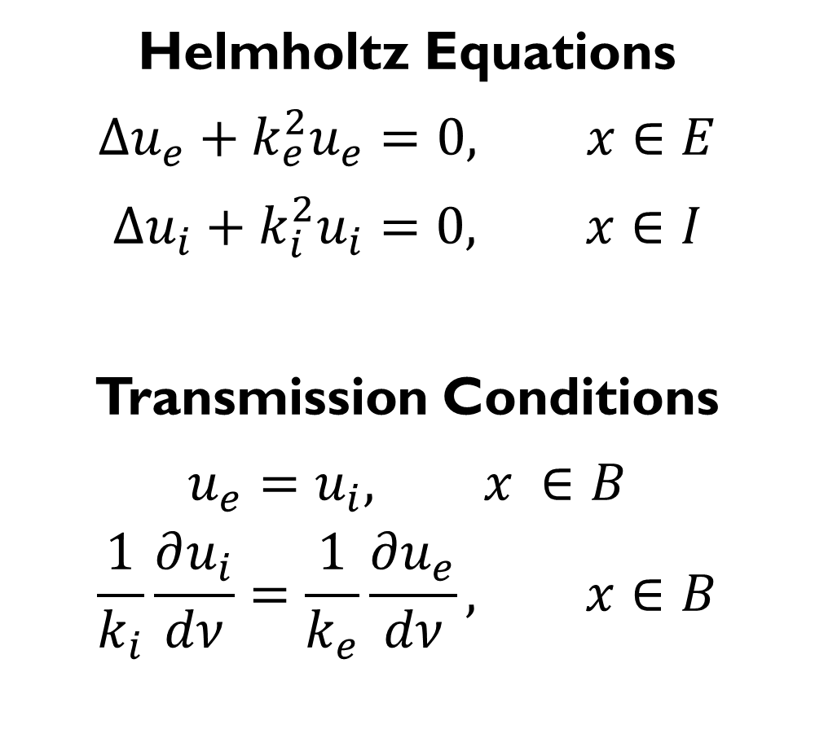
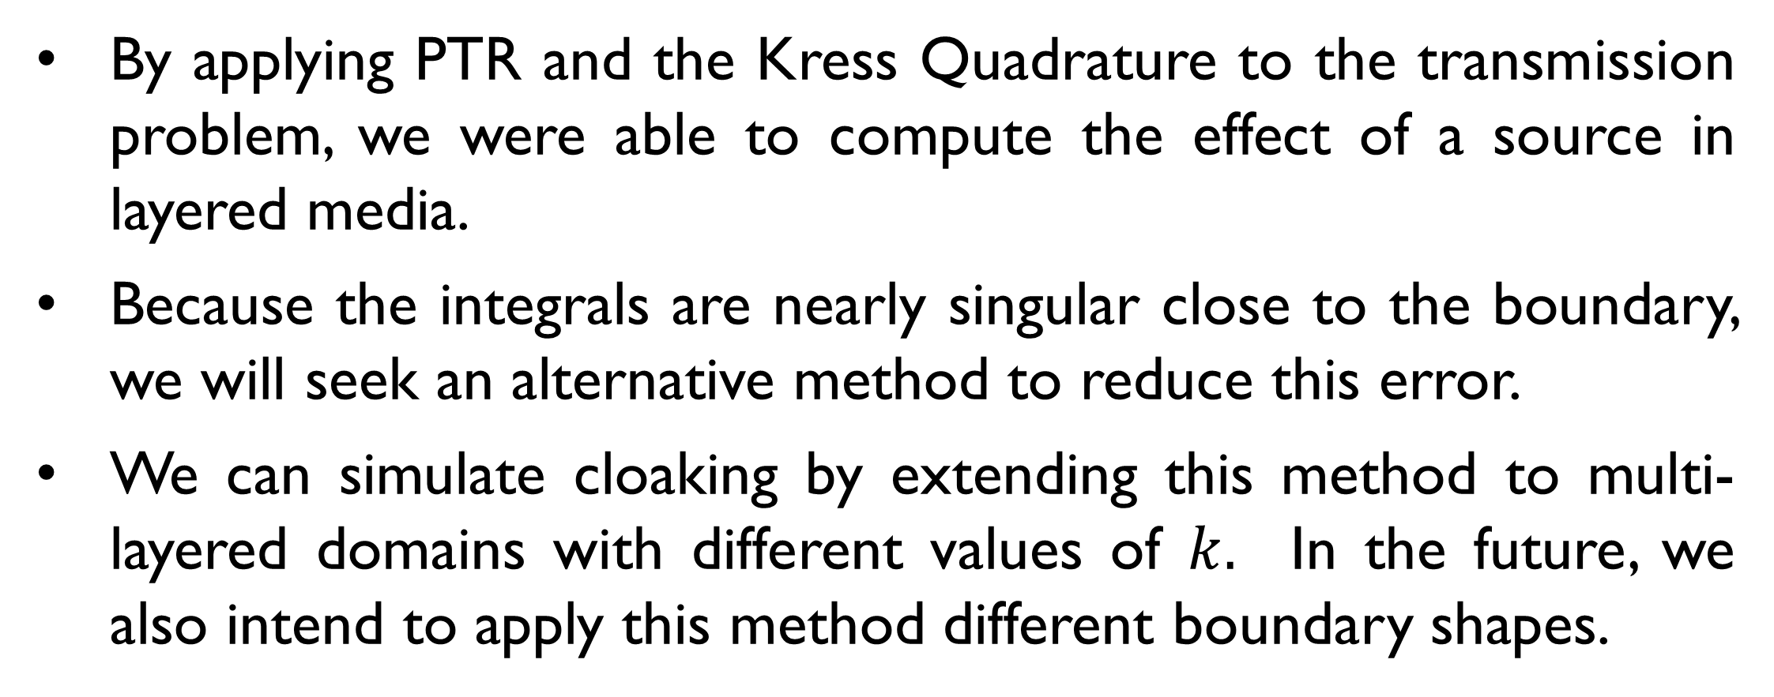
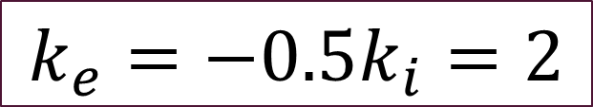

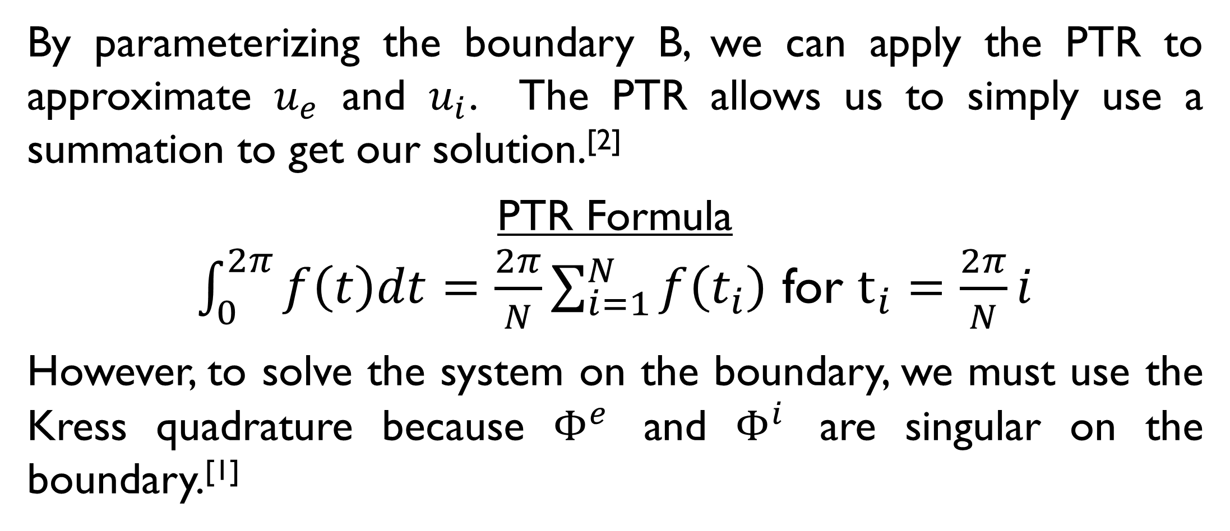

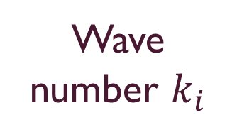

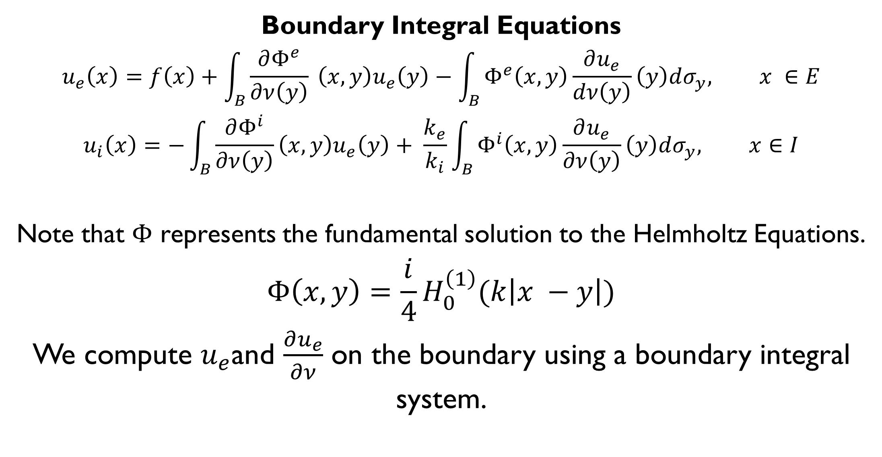


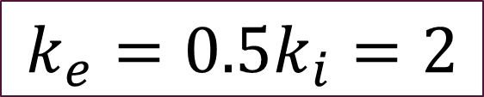



Cloaking using Periodic Trapezoid Rule Approximation of Boundary Integrals
E. A. Cortes, C. Carvalho, School of Natural Sciences, University of California, Merced
Introduction
Numerical Method
Transmission
Our goal is to simulate optical cloaking devices by calculating how light travels through defined boundaries. Optical cloaking refers to the act of making something invisible in some directions by preventing the scattering of light as it hits the boundary. Cloaking is often seen in science fiction, but also has real-world applications for radar and military science.
We use boundary integral equation methods to compute the solution in layered boundaries, and we implement in Python an approximation using the periodic trapezoid (PTR) and the Kress Quadrature.^{[1]}
By parameterizing the boundary B, we can apply the PTR to approximate $u_{e}$ and $u_{i}$. The PTR allows us to simply use a summation to get our solution.^{[2]}
PTR Formula
$\int_{0}^{2π}{f\left(t\right)dt=\frac{2π}{N}\sum_{i=1}^{N}{f\left(t_{i}\right)}}$ for $t_{i}=\frac{2π}{N}i$
However, to solve the system on the boundary, we must use the Kress quadrature because $Φ^{e}$ and $Φ^{i}$ are singular on the boundary.^{[1]}
Our method can be extended to the transmission of a source in domains with different properties.
$$k_{e}=0.5k_{i}=2$$
Real Part of PTR
Imaginary Part of PTR
Body-Fitted Grid
$$k_{e}=−0.5k_{i}=2$$
Figure 1. The scattering of light on an uncloaked object (left) versus that of a cloaked object (right).^{[4]}
$$t_{j}$$
PTR sums
Real Part of PTR
Imaginary Part of PTR
Figure 2. We compute the solution on the body-fitted grid using the PTR. The solution is computed in layers.
Different behaviors appear for different k values.
Transmission Problem
Preliminary Results
Conclusions
Solution $u_{e}$
$$x= <x_{1},x_{2}>$$
In order to validate our method, we computed the solution which is known for:
$$f\left(x\right)=e^{ik_{e}\left(\cos\left(π/4\right)x+\sin\left(π/4\right)y\right)}$$
$$k_{e}=k_{i }=3$$
By applying PTR and the Kress Quadrature to the transmission problem, we were able to compute the effect of a source in layered media.
Because the integrals are nearly singular close to the boundary, we will seek an alternative method to reduce this error.
We can simulate cloaking by extending this method to multi-layered domains with different values of $k.$ In the future, we also intend to apply this method different boundary shapes.
E
Helmholtz Equations
$$∆u_{e}+k_{e}^{2}u_{e}=0, x∈E$$
$$∆u_{i}+k_{i}^{2}u_{i}=0, x∈I$$
Transmission Conditions
$$u_{e}=u_{i}, x ∈B$$
$$\frac{1}{k_{i}}\frac{∂u_{i}}{dν}=\frac{1}{k_{e}}\frac{∂u_{e}}{dν}, x∈B$$
I
B
Data $f$
Solution $u_{i}$
Wave number $k_{i}$
$$y= <y_{1},y_{2}>$$
$$ν$$
Figure 3a. Top-down plot of the real part (left) and the imaginary part (right) of the PTR solution for an ellipse-shaped boundary with N = 300 points on the boundary.^{[3]}
Wave number $k_{e}$
REFERENCES
[1] R. Kress, Boundary Integral Equations in Time-Harmonic Acoustic Scattering. Math Comput. Model (1991).
[2] C. Carvalho, S. Khatri, and A.D. Kim, Asymptotic analysis for close evaluation of layer potentials, submitted. J. Comp. Phys. (2018).
[3] Boundary Cloaking GitHub Repository, code available: https://github.com/eangelcortes/boundary_cloaking (2019).
[4] V. Shalaev, Illustration of a theoretical cloaking device. (2007).
Boundary Integral Equations
$$u_{e}\left(x\right)=f\left(x\right)+\int_{B}{\frac{∂Φ^{e}}{∂ν\left(y\right)}} \left(x, y\right)u_{e}\left(y\right)−\int_{B}{Φ^{e}\left(x,y\right)\frac{∂u_{e}}{dν\left(y\right)}\left(y\right)dσ_{y}, x ∈E}$$
$$u_{i}\left(x\right)=−\int_{B}{\frac{∂Φ^{i}}{∂ν\left(y\right)}\left(x, y\right)u_{e}\left(y\right)+ \frac{k_{e}}{k_{i}}\int_{B}{Φ^{i}\left(x,y\right)\frac{∂u_{e}}{∂ν\left(y\right)}\left(y\right)dσ_{y}, x∈I}}$$
Note that $Φ$ represents the fundamental solution to the Helmholtz Equations.
$$Φ\left(x,y\right)=\frac{i}{4}H_{0}^{\left(1\right)}(k\left|x −y\right|)$$
We compute $u_{e}$and $\frac{∂u_{e}}{∂ν}$ on the boundary using a boundary integral system.
Figure 3b. Top-down plot of the real part (left) and the imaginary part (right) of the exact solution for a plane wave acting on an ellipse boundary.^{[3]}
Figure 4. The log plot of the error between the PTR solution and the exact solution shown. There is a significant increase in error around the defined boundary. The reason is because we compute nearly singular intervals.

